Slide 1
Flexible and Peak Demand Resource Requirements Presented by: Gary Dorris, PhD gdorris@ascendanalytics.com 303.415.0311 June 8, 2017

Slide 2
Questions Addressed
How does PowerSimm identify capacity and capacity attribute needs for an individual utility and for the region? How does it differ from how other modeling tools identify needs?
How does your modeling tool characterize the capabilities of resources to provide capacity and capacity attributes? How does it differ from other tools?
How does your modeling approach address the opportunity for regional resource sharing?

Slide 3
Addressing Commission Comments from the 2015 IRP ETAC April 26, 2017
Comment Topic | Issue | Response
Resource adequacy | NorthWestern has not completed a system optimization study with its entire fleet of resources to determine what capacity its base portfolio provides and, thus, what type of incremental capacity is needed The Plan provides little analysis and documentation that supports its selected capacity acquisition rate produces “minimal resource adequacy” by 2028. NorthWestern’s resource adequacy should be measured by its retail load’s position relative to the region’s or interconnection’s peak demand, while taking into consideration import limitations. | An exhaustive portfolio analysis was conducted across hundreds of possible future states. See slides 7-10* Ascend performed an optimal expansion plan. see slide 10* Agree that the discussion, explanation of methodology, and presentation of results was limited. Agree in principal. NWE and Ascend are expanding analysis to encapsulate the broader WECC environment. See slides 33 – 54*
Scope of resource alternatives | The Commission shares many of these concerns and finds that NorthWestern’s 2015 Plan falls short of an “evaluation of the full range of cost effective supply and demand-side management options” | This is incorrect except for demand side management, which was not evaluated. Going forward, the full suite of technologies identified by the commission in their comments will be evaluated. See slides 16 – 20*
*Slides refer to April 26, 2017 ETAC

Slide 4
Capacity Needs
1) Capacity to Meet Peak Demand
Requirement: Procure adequate supply to serve peak demand given potential for generation outages and intermittency of renewable supply
Measurement: Traditionally reserve margin = firm capacity in excess of peak load
Assessment of need: Best modeled by simulating available capacity and load over a large variety of future conditions for meteorology and generation outages
2) Flexibility Resource Needs
Required by regional balancing authorities to keep system at 60 Hz
Ascend’s PowerFlex determines the flexible resource requirements as a function of renewable generation
Fast Ramp (Regulation) ~ 1 minute ramp
Slow Ramp ~ 15 minute ramp

Slide 5
Calculation of Loss of Load Probability
Weather drives load and renewable generation
Simulated renewables generation & load
Simulated generation outages
Hydro Gen
+
Capability to serve peak load
=
Simulated Weather
Renewables
Generation outages
PowerSimm captures the interactions of weather→ renewables, hydro, and load and generation
Note: Competing models to PowerSimm don’t simulate full generation outages with expected duration and variance in outage duration. Traditional models use an expected outage rate times available capacity in a deterministic construct. Thus, they can’t calculate probability of outages.
Load

Slide 6
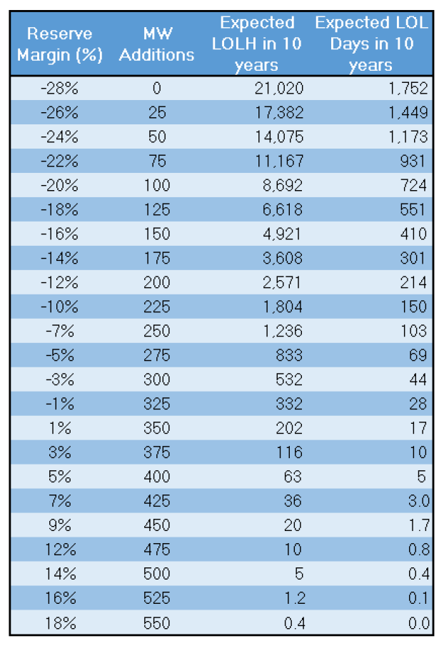
Resource Adequacy
PowerSimm’s simulation framework captures the structural relation of weather with renewables and load over a wide range of future conditions
Hours Short by Year

Slide 7
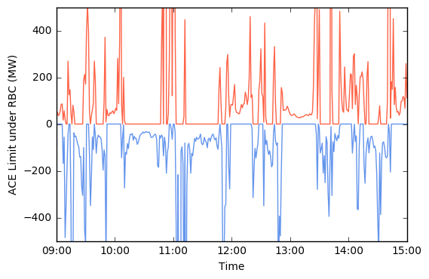
Flexibility Resource Requirements
NWE is now required to meet the RBC standard for Area Control Error (ACE). At every moment, dynamic ACE limits are applied as a function of WECC frequency instead of the constant ACE limit used under CPS2.
This change in standard ensures that all balancing area responses to ACE move in the right direction for overall grid frequency.
The balancing area can exceed limits for 30 minutes before it is considered a violation.
WECC Frequency > 60 Hz → upper limit on ACE
WECC Frequency < 60 Hz → lower limit on ACE

Slide 8
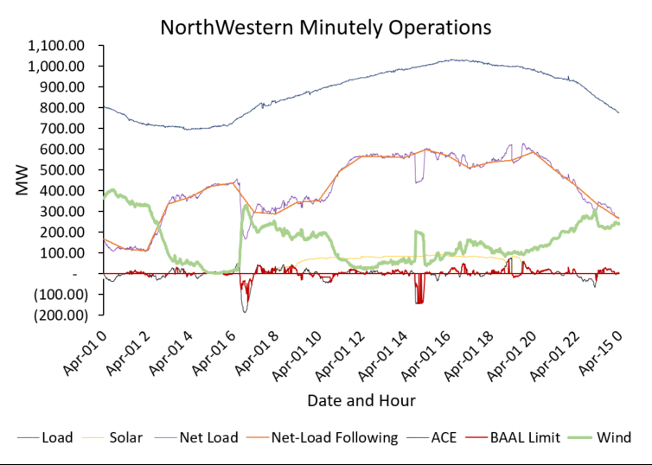
Minutely Dispatch and Regulation
2020 Baseline + 200 MW Wind
+ 100 MW Solar
Solar 1 MW ~ 0.2 MW flexible resources
Wind 1 MW ~ 0.6 MW of flexible resources
Changes in gradient of net load
Base load 3 Δ’s in gradient
Net load 7 Δ’s in gradient

Slide 9
Total Flexibility Requirements in NWE – Minimizing Fast Ramp
Flexible requirement = 15 minute ramp (Inc) + 1 minute ramp (Regulation)
Illustration of Flexible Capacity Requirement
Year | Scenario | Inc Capacity | Regulation Capacity | Flexible Requirements
2016 | Base | 168 | 28 | 196
2017 | Base | 169 | 28 | 197
2018 | Base | 186 | 33 | 219
2019 | Base | 226 | 40 | 266
2020 | Base | 226 | 40 | 266
2020 | +100 MW Solar | 244 | 44 | 288
2020 | +200 MW Wind | 329 | 65 | 394
2020 | + 100MW Solar + 200MW Wind | 333 | 67 | 400
Increasing renewable penetration causes growth in system flexibility requirements.

Slide 10
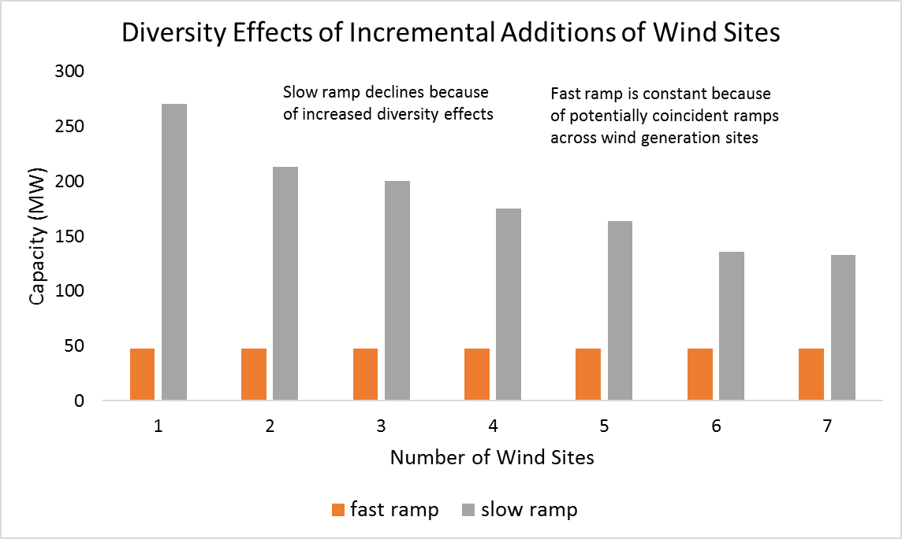
Flexible Resource Requirements as a Function of Geographic Diversity
Increasing geographic diversity of renewable resources helps mitigate the variability of renewable output.

Slide 11
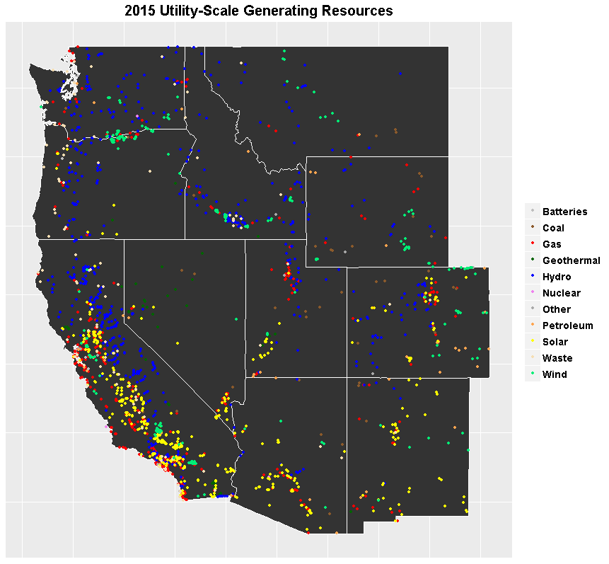
Market Potential for Capacity Energy Flows throughout the WECC
PowerSimm performs fundamental modeling of the WECC region inclusive of transmission congestion and losses determined through an integrated generation dispatch and DC optimal power flow model.
Major interties support seasonal flow of power N to S (summer) and S to N (winter)
California imports about 20% of energy
During the solar peak, CA exports to the neighboring states.
Wind and hydro are predominant in the Northwest
Solar dominates CA, but also significant penetration in AZ, UT, NM, NV, NM, and CO

Slide 12
Market Potential for Resource Adequacy
Fundamental modeling with PowerSimm suggest contracting for capacity and flexible reserves can be attractive but potential physical limits exist:
Transmission constraints
Regional deficit of flexible capacity
Regulation prices in CA increased in 2017 by 400% over previous four years
Regional capacity deficit projected ~ 2020
Renewables provide negligable amount of dependable capacity
Modeling is no substitute for testing the market with solicitations
Solicitation will provide the most competitive responses for evaluation
Economic offers need to assessed relative to portfolio needs

Slide 13
PowerSimm Compared to Other Solutions
Capability | Competitors | Ascend
Detailed sub hourly dispatch optimization | ü | ü
Flexible requirements as function of renewables | X | ü
Integrated ability to calculate peak resource (MW) | X | ü
Simulated weather, load, renewables, price | X | ü
Substantiate “meaningful uncertainty” | X | ü
Match market vols, heat rates, and prices | X | ü
Optimal expansion planning under uncertainty | X | ü
Transmission modeling | ü | ü
Statistical summarization of output variables | X | ü
Rapid response parallel summarization process | X | ü

Slide 14
Contact Information
Offices & Officers
Headquarters:
1877 Broadway St
Suite 706
Boulder, CO 80302
(303) 415-1400
Other Offices:
Oakland, CA
Bozeman, MT
Providence, RI
Gary Dorris +1 (303) 415 0311
President gdorris@ascendanalytics.com

Slide 15
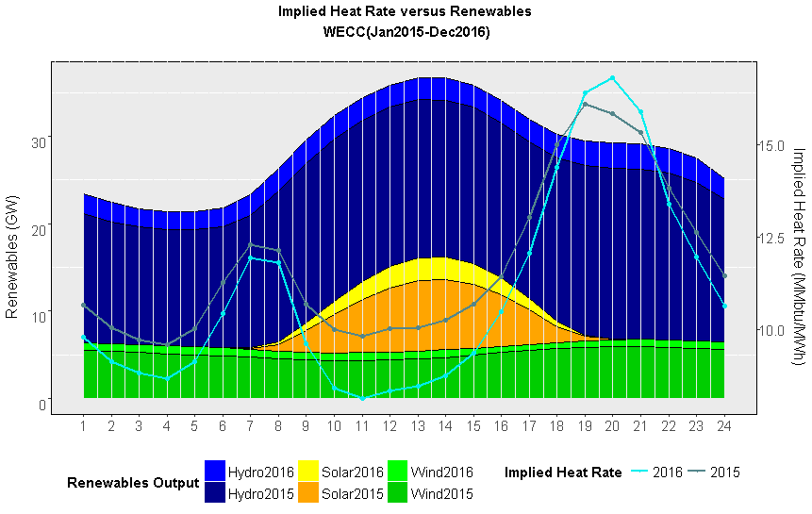
Changing Market Dynamics as a Function of Renewables
Hour

Slide 16
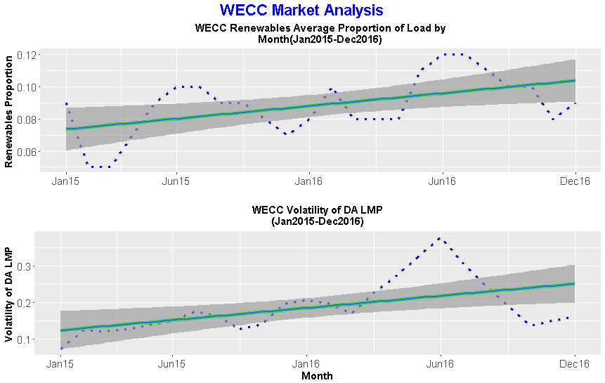
Observed and forecasted increases in price volatility through time WECC
10%
7%
Mid-C Volatility of DA LMP
25%
11%

Slide 17
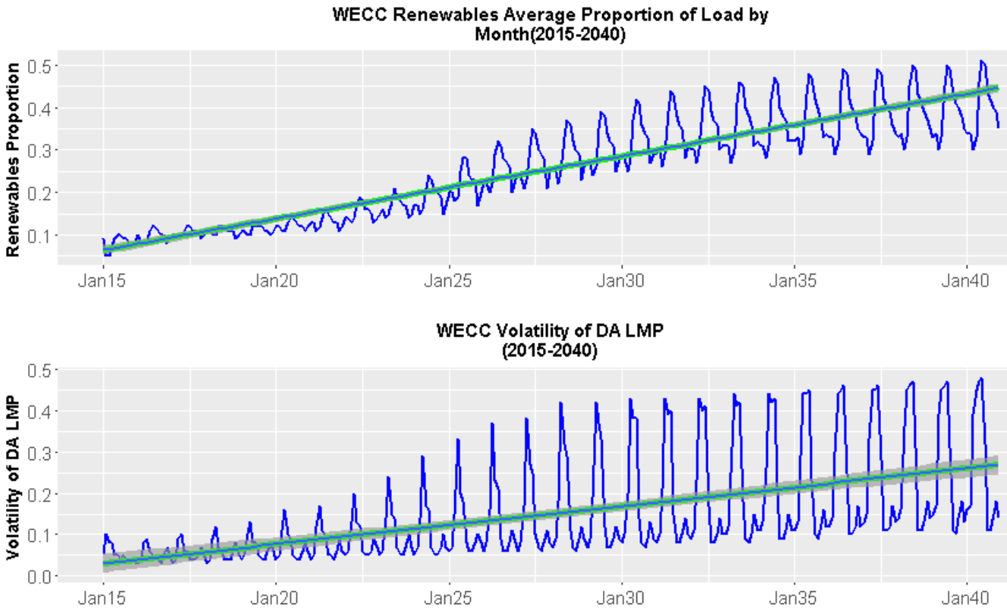
Relationship between renewables and market volatility
WECC Market Analysis
Recorded
Forecast
Recorded
Forecast
Market price volatility is expected to increase as renewable generation increases.
Greater premium on highly flexible capacity
By 2027 the growth in price volatility diminishes.
Volatility peaks during the summer months.

