Slide 1
MPSC Technical Conference June 8, 2017

Slide 2
Overview
PNW Region needs capacity
Coal plant closures
Addition of renewables
NWE has a very large and ongoing need for capacity
Need for flexible capacity to integrate renewables
Region and NWE peak loads hour overlap
NWE can’t continue to “lean” on the region
2015 Plan identifies gas-fired generation
NWE using RFP to define resources
Notes:
Since the WECC was significantly long generation, the Regional Reserve Requirement was not enforced at a company level.
With the retirements, regional companies will be closer to the Reserve Requirement and those that are short will be required to fulfill their obligation.
Penalties will be instituted as the need arises.

Slide 3
Regional View
NERC R- Reference Reserve Margin Requirement:
12/2016 NWPP-US = 16.16%
Resource Adequacy Advisory Committee (RAAC)
2015 Plan - region short in 2021
2017 report – region is still short in 2021
PNUCC Annual forecast continues to affirm our concern about winter capacity
2017 Northwest Regional Forecast
Notes:
Since the WECC was significantly long generation, the Regional Reserve Requirement was not enforced at a company level.
With the retirements, regional companies will be closer to the Reserve Requirement and those that are short will be required to fulfill their obligation.
Penalties will be instituted as the need arises.

Slide 4
Regional View
Capacity Planning / Resource Adequacy
Shift in Resource Planning Priorities
NWPCC – First Plan to recognize and place priority on capacity planning.
Energy planning no longer “good enough”
Peak and flexibility need to be considered
No renewable resources beyond RPS
Regional Coal Plant Closures
2015 J.E. Corette 175 MW
2020 Centralia Unit One 670 MW
2021 Boardman 550 MW
2025 Centralia Unit Two 670 MW
2025 North Valmy 552 MW
Total: 2,617 MW
Since 2015 Plan – Colstrip 1 and 2 / PacifiCorp 2017 IRP
Notes:
Since the WECC was significantly long generation, the Regional Reserve Requirement was not enforced at a company level.
With the retirements, regional companies will be closer to the Reserve Requirement and those that are short will be required to fulfill their obligation.
Penalties will be instituted as the need arises.

Slide 5
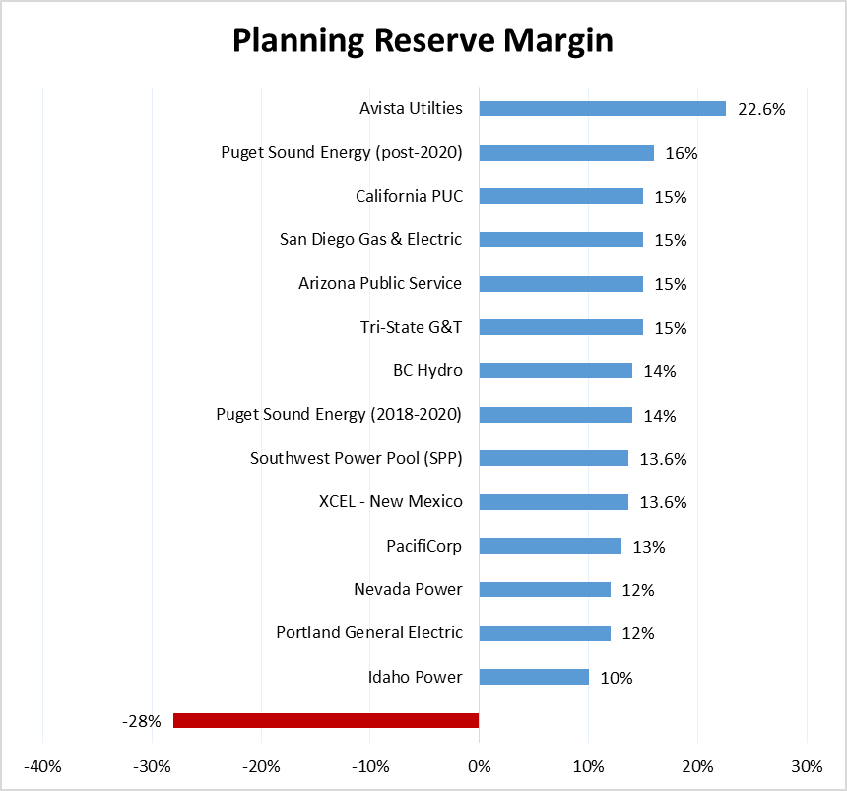
Regional View
Planning Reserve Margins
NERC Reference Margin
NWPP-US Reference Margin = 16.16%
Comparison of Select Regional Utilities
NorthWestern did not plan for capacity prior to the 2015 Plan
NorthWestern has no planning reserve margin and, is currently negative.
NorthWestern Energy

Slide 6
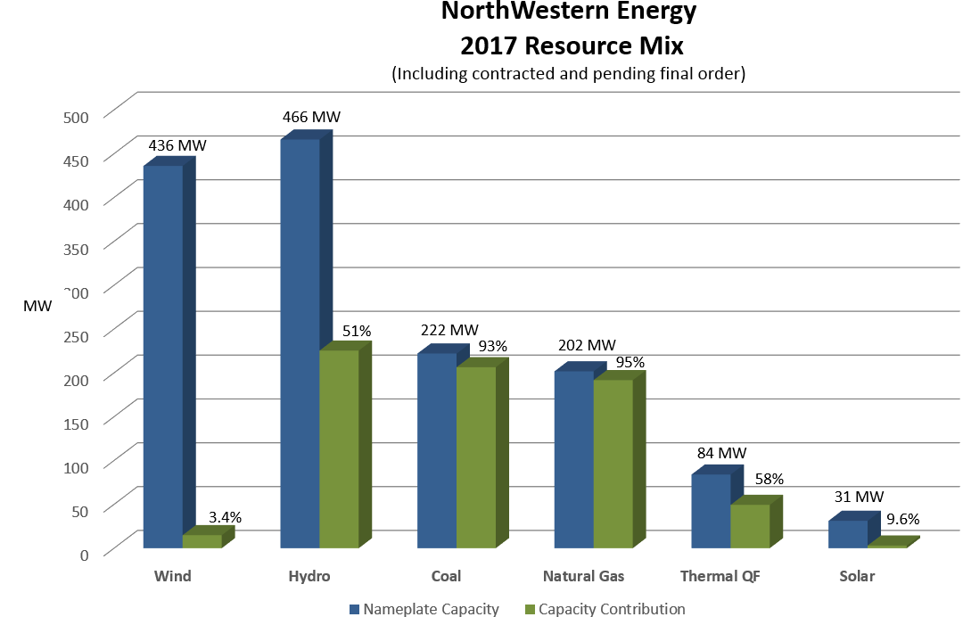
Physical Resources
Notes:
Add table; increase number slides, add percentages, Contribution to historic peak is 57%

Slide 7
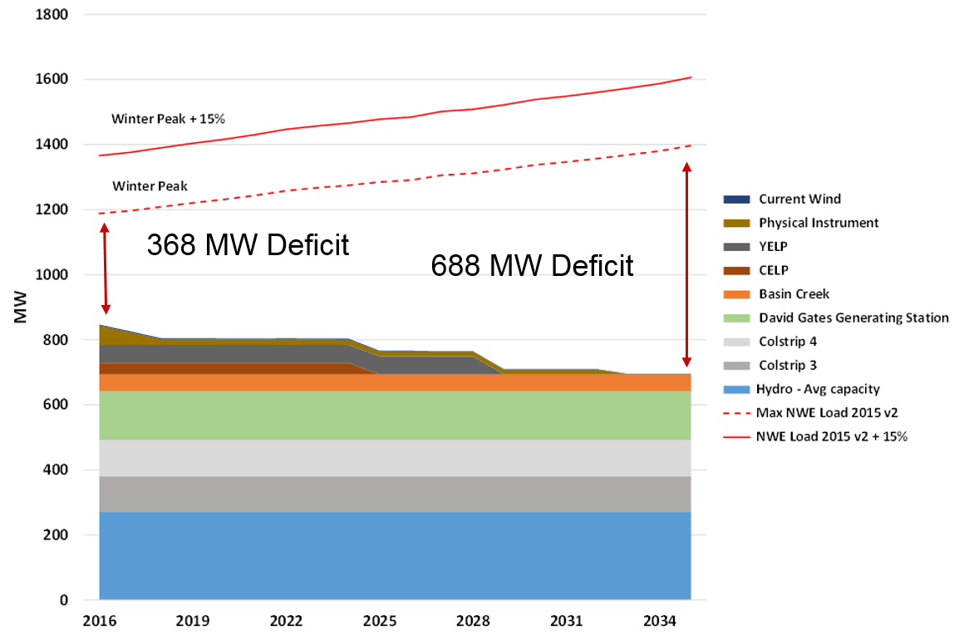
NWE Capacity Need
NorthWestern’s capacity deficit is large and grows over time

Slide 8
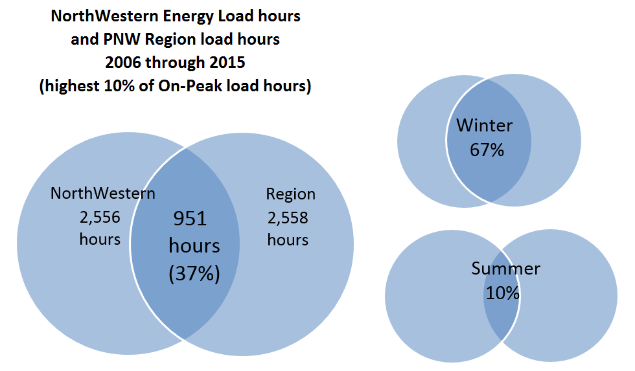
Region / NorthWestern Coincidental Peak
Notes:
Take off Summer

Slide 9
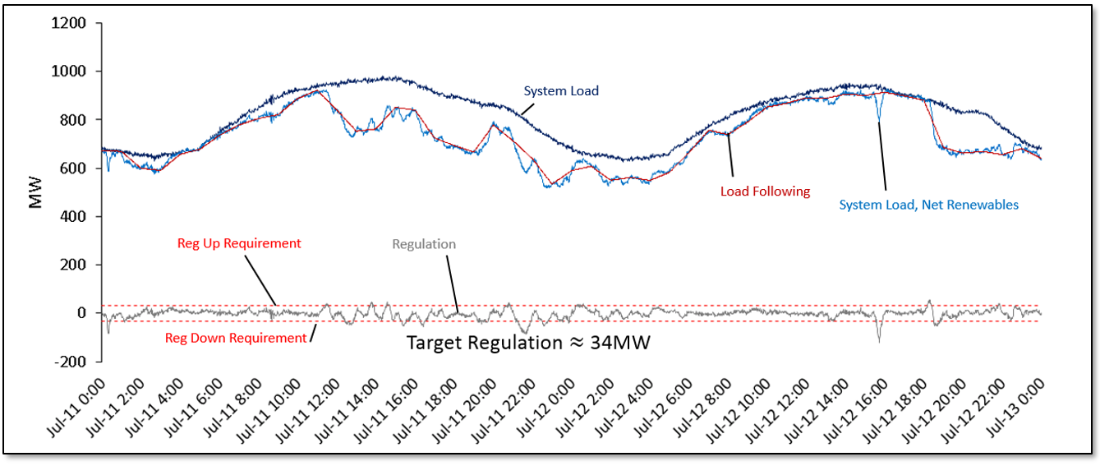
Optimization
Resource & Portfolio Optimization
Define & leverage hydro flexibility
Separate regulation and load following
Reduce regulation value and perform service more efficiently
Meet load following across larger time steps

Slide 10
Flexible Capacity Need and Resources
Notes:
Update and move to end

Slide 11
Flexible Capacity Need and Resources
Total: 271
Notes:
Update and move to end

Slide 12
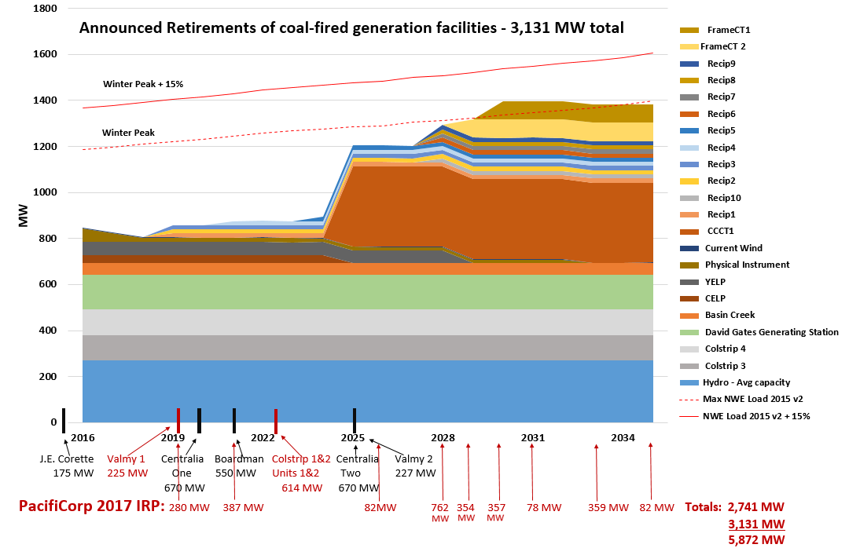
NWE Preferred Portfolio
Notes:
Increase winter peak fonts; Winter peak plus Reserve Margin

Slide 13
NWE Flexible Capacity RFP
NorthWestern RFP - 5 MW to 150 MW
Must be dispatchable by NorthWestern (PPA or Owned)
Two “Silos” in RFP
Engineer, procure and construct at DGGS site:
All source side open to the following technologies:
Thermal
Thermal
Solar or Wind (with storage)
Hydro
Demand Response
Biomass / biogas
Geothermal
Storage only technologies
Notes:
Since the WECC was significantly long generation, the Regional Reserve Requirement was not enforced at a company level.
With the retirements, regional companies will be closer to the Reserve Requirement and those that are short will be required to fulfill their obligation.
Penalties will be instituted as the need arises.

Slide 14
Takeaways
PNW Region needs capacity
NWE has a very large and ongoing need for capacity
Need for flexible capacity
Region and NWE peak loads hour overlap
Coal plant closures
Addition of renewables
NWE can’t continue to “lean” on the region
2015 Plan identifies gas-fired generation
NWE using RFP to define resources
Notes:
Since the WECC was significantly long generation, the Regional Reserve Requirement was not enforced at a company level.
With the retirements, regional companies will be closer to the Reserve Requirement and those that are short will be required to fulfill their obligation.
Penalties will be instituted as the need arises.

