Slide 1
MPSC Capacity Conference
DSS
Introduction to MADA Power
WIND
Energy
Processing:
Beyond Energy
Storage
Copyright MADA Power 2013-2016

Slide 2
The MADA Team
MADA
TEAM
NREL
SNC Lavalin
Modeling & Optimization
Legal, Tax and Financing
GE- Highview
Copyright MADA Power 2013-2016

Slide 3
MADA’s Technology
Copyright MADA Power 2013-2016

Slide 4
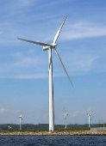
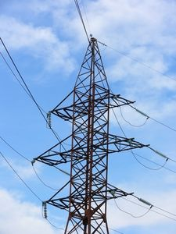
Making Wind Reliable Capacity
MADA Combined Energy Storage/Power Generation System
Wind
(80MW)
MEPS™
Control
System
Input
Direct Wind By-Passes Storage When Possible
MEPS™
Control
System
Output
Highview/MADA
Energy Storage *
67MW
~60% RE
GRID
Gas Turbine
(Backup)
Gas
* 10 minute battery can be added for instant response
Copyright MADA Power 2013-2016
4

Slide 5
Highview/MADA Liquid Air Energy Storage
Hot Thermal Store
Power In
Compression
Refrigeration
LAES
Evaporation
Expansion
Power Out
Cleaning
High Grade Cold Store
Air In
Air Out
CHARGE
STORE
DISCHARGE
Copyright MADA Power 2013-2016
5

Slide 6
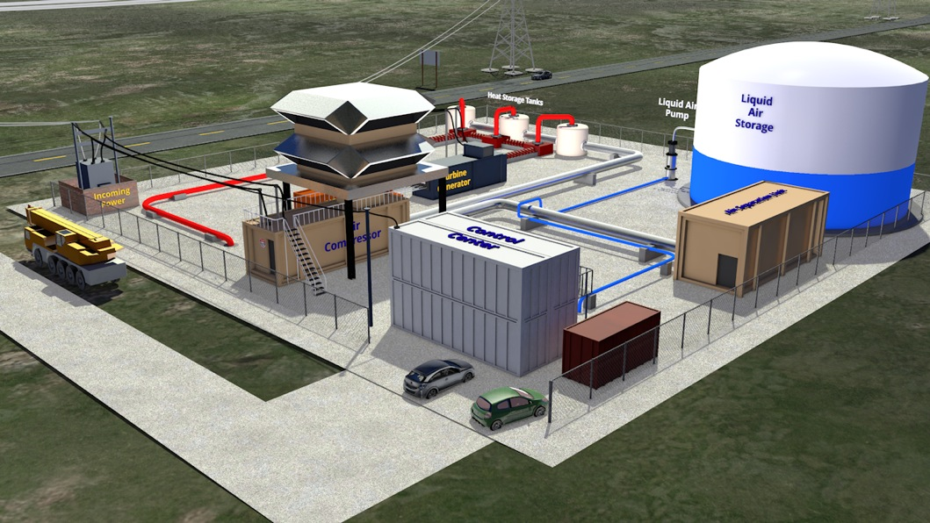
Illustration of MADA Combined Energy Storage/Power Generation Facility
Copyright MADA Power 2013-2016

Slide 7
MADA Technology - Ready for Deployment
“Conventional equipment used unconventionally”
Highview/MADA LAES is extension of proven CAES technology, compressing air from gas to liquid with standard techniques and equipment from the air products, LNG, and power generation industries. Two plants are currently operational.
MADA’s Energy Processing control system utilizes traditional DCS platforms with proprietary algorithms based on those extensively used for process control.
SNC Lavalin has provided support for two years:
Indicated a willingness to participate in project ownership, provide cost and performance wraps secured by that position.
Verified the operating regime to provide gas plant back-up.
Copyright MADA Power 2013-2016

Slide 8
Benefits of MADA CES/PG System
Converts NWE’s existing, contracted, but intermittent wind into firm, dispatchable capacity
Combined capacity range: 77MW = -10MW to +67MW
Provides regulation services equivalent to 670MWh Battery:
Spinning Reserve
Voltage Regulation (Line Frequency)
High frequency peak shaving with LAES and Gas Turbine
Less exposure to gas-price escalation because of significantly lower gas usage
Total Life-Cycle cost almost 40% less than power from 100% gas turbine power
Montana will become a leader in addressing today’s most important issue – making intermittent generation dispatchable capacity
Copyright MADA Power 2013-2016

