Slide 1
Demand Response Capacity Resources
June 8, 2017
Montana PSC Technical Conference Capacity Planning and Resource Adequacy

Slide 2
Integrated Resource Planning paradigm has changed
Roof Top Solar
Energy Efficiency Technologies
Duck Curve
Intermittency
Grid Scale Renewable Projects
Battery Storage
Energy PTC/ITC Policy
Demand Management
Grid Defection
Climate Policy
Energy Data Analytics
Demand Destruction
Natural Gas Prices
Electric Vehicle Charging
RTO/ISO/EIB Markets
Demand flexibility and automated controls

Slide 3
Resource planning with normal levels of uncertainty
Upgraded capacity
MW
Construction lead time
Projected peak demand
Available capacity
Today
Years ahead

Slide 4
Resource planning with today’s uncertainty
Upgraded capacity
MW
Projected peak demand
Available capacity
Today
Years ahead

Slide 5
You can use DR to buy time to make a better decision
MW
Extra time
Projected peak demand
Capacity with DR
Available capacity
Today
Years ahead

Slide 6
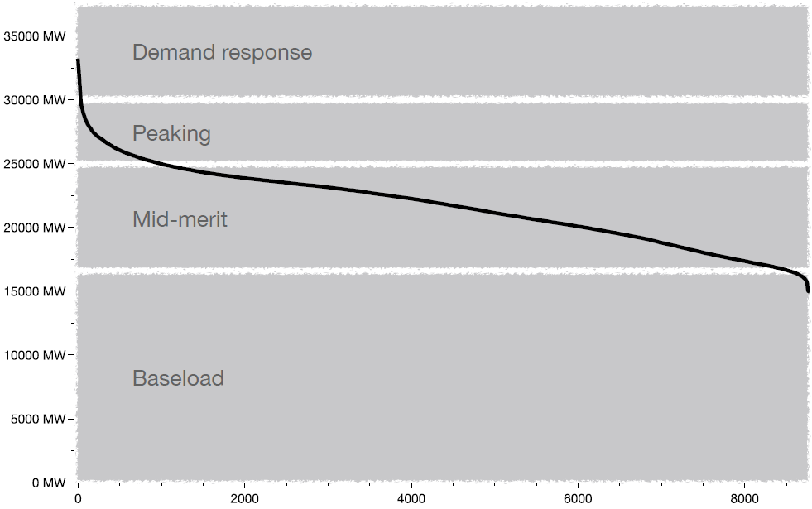
DR has proven its value as planning reserve capacity
Key DR attributes
Capital efficient
Fast-to-market
Dispatchable
Reliable
Clean
Key DR benefits
Improved system reliability
Lower electricity prices
Industrial competitiveness
Higher renewables penetration
1: Navigant Research

Slide 7
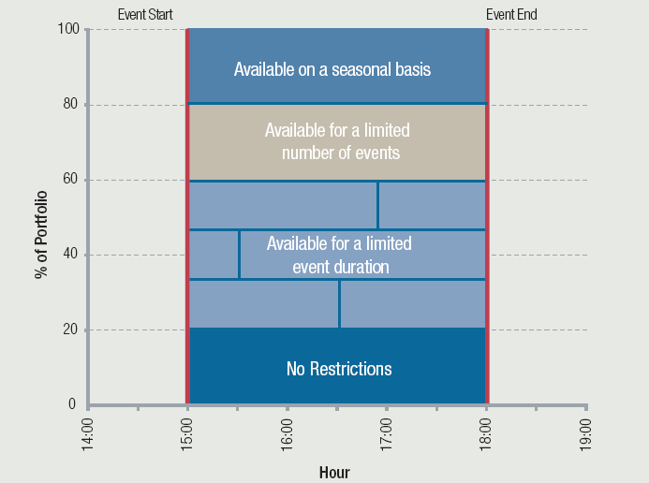
DR Aggregators work with utilities to build portfolios
Basic model of DR aggregation
Utility DR tariff arrangements are suboptimal.
DR Aggregators have flexibility of contract with customers.
DR aggregation allows more customers to do DR (more MW)
Customer capabilities
Utility and grid operator needs

Slide 8
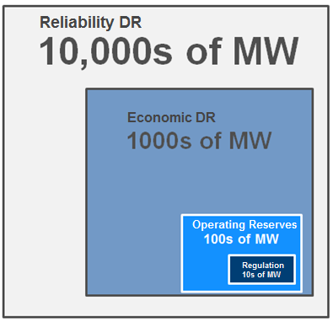
Capacity DR is the anchor, but it unleashes flexible resources
Reliability DR (Capacity/Strategic Reserves)
Typical dispatch: 4 hours duration;
1-2x/year; 60-minute notice
Load reduction only
PJM 2015: 11,000 MW
Economic DR (Energy)
Typical dispatch: 5-minute to multiple hours duration; 100+ hours/year,1 hour to 5-minute notice
Load reduction only
PJM 2015: 2,600 MW
Operating Reserves (Secondary Reserves)
Typical dispatch: ~20x/year; ~30-minute duration; 10-minute notice
Load reduction or increase
PJM 2015: 360 MW
Regulation (Primary Reserves)
Typical dispatch: Continuous; minutes to hours duration; 6-second notice
Load reduction or increase
PJM 2015: 13 MW
Potential
Capacity: ~90MW
Flex: ~35MW

Slide 9
Program design is key to DR viability & uptake
Level of customer participation
Low
High
All hours
Critical hours only
Resource availability
Event trigger
Arbitrary
Needs-based / transparent
Instantaneous
Minutes / hours
Advance notice
Unlimited
Fixed / short
Event duration
None
Daily / annual limits
Deter
Event limits
Encourage
Overly complex
Adequate / reasonable
Technology requirements
Complex / biased
Simple / accurate / fair
Baseline
None
By total portfolio
Aggregation
Energy only
Availability and energy
Payments
Severe
Reasonable
Non-compliance penalties

Slide 10
Kenneth D. Schisler
Vice President of Regulatory Affairs
+1 410-725-1462
kschisler@enernoc.com

