Slide 1
Ternary Pumped Storage Flexible Capacity Assessment
Prepared for Absaroka Energy in response to NorthWestern Energy’s 2015 Electricity Supply Resource Procurement Plan
5/8/2017
Arne Olson, Partner
Doug Allen, Managing Consultant
Vivian Li, Associate

Slide 2
Analysis Description
Absaroka Energy LLC asked E3 to compare their ternary pumped storage technology to conventional resources in terms of their ability to provide “flexible capacity”
Conventional resources considered: Internal Combustion (Reciprocating) Engine, Frame Combustion Turbine, Aeroderivative Combustion Turbine
Flexible capacity does not have a specific definition, so we have looked at each resource’s ability to provide
System capacity
Ancillary Services

Slide 3
Flexible Capacity Cost Comparison
Nameplate Capacity | Frequency Response | Regulation Up/Down | Spinning Reserves | Non-spinning Reserves
Ability to provide capacity during peak events and contribute to required reserve margins | Most immediate response to deviations in grid frequency served by generator inertia | Provided by generators that are online and have capacity to increase or decrease generation output or load consumption (pumping) | Provided by units that are synchronized to the grid and, upon dispatch, able to ramp up within specified time frame | Provided by units that need not be synchronized to the grid, but are able to ramp up generation within specified time frame upon dispatch
Capital Cost Analysis
$$Product Specific Cost \left(\frac{\$}{kW}\right)=\frac{{Capital Costs}^{∗} (\frac{\$}{kW})}{Product Specific Usable Capacity (\%)}$$
* Capital costs considered in this analysis include infrastructure costs as detailed in the 2015 NWE Electricity Supply Resource Procurement Plan

Slide 4
Cost Comparison
For each capacity product, we describe the ability of the different generating technologies to supply that product
We then calculate the product-specific cost per kW by technology
Allows for more balanced comparison of “capacity cost” than a simple $/kW installed cost
This comparison focuses on costs per unit of flexible capacity only, and does not include an analysis of potential revenues

Slide 5
Comparison Scope
This analysis looks solely at the comparative capital costs (per installed kW) of the different technologies
Accounts for each technology’s ability to provide different capacity services
Does not account for
Fuel / Variable Operating costs
Revenues from participation in energy markets
Potential impacts of carbon price or air quality operating restrictions
Carbon benefits of absorbing renewable overgeneration for later use

Slide 6
Assumptions
 |  | Ternary Pumped Storage | Natural Gas Simple Cycle†
Operating Characteristic | Units | Pumped Storage Hydro (PS)* | Internal Combustion Engine (ICE) | Aeroderivative Combustion Turbine (Aero) | Frame Combustion Turbine (Frame)
Technology | - | Ternary Unit | Warsila 18V50SG | GE LMS100 | GE 7EA
Capacity | MW | 150 | 18 | 93 | 79
Capital Costs◊ | $/kW | $2,439 | $1,756 | $1,684 | $1,459
Ramp Rate | MW/min | 300 | 4 | 10 | 4
Start Time | min | 0.4 – 1.5 | not reported | not reported | not reported
Shut-down Time | min | 2∆ | not reported | not reported | not reported
Min Run Time | Hours | not reported | 1 | 8 | 8
Min Down Time | Hours | not reported | 1 | 7 | 7
Operating Range | [min –max, as % of capacity] | -100% (pumping) – +100% (generating) | 21%-100% | 53%-100% | 13%-100%
* Data provided by Absaroka
† All Data taken from Thermal Resource Operating Parameters section of the NorthWestern Energy 2015 Electricity Supply Resource Procurement Plan
∆ Assuming “transfer mode” as the final state of rest
◊ Includes “Infrastructure” costs as described in NWE’s Procurement Plan

Slide 7
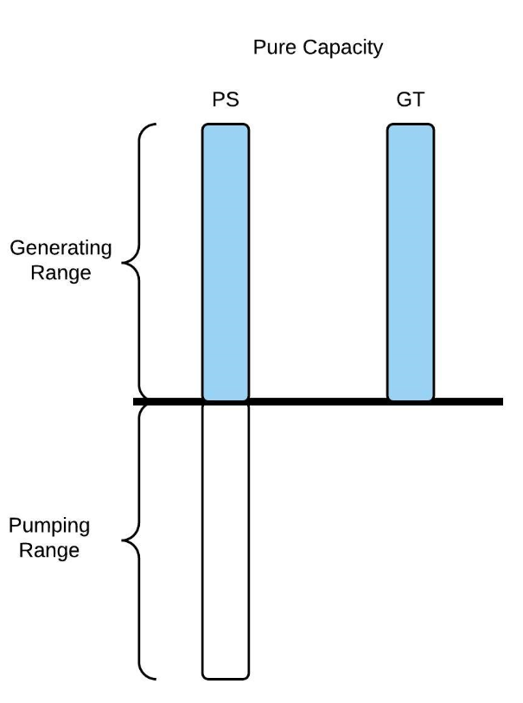
Nameplate Capacity
Usable capacity provided by the unit (as listed in the NWE Procurement Plan)
Reflects the unit’s contribution to reserve margins / system capacity
Amount of capacity available to meet peak capacity needs
 | Capacity Assumptions | Capital Costs (2018 $/kW)
PS | Generation rated power = 150 MW Pumping rated load = 150 MW | $2,439
ICE | Generation rated power = 18 MW | $1,756
Aero | Generation rated power = 93 MW | $1,684
Frame | Generation rated power = 79 MW | $1,459

Slide 8
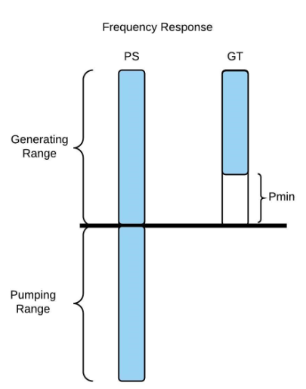
Flexible Capacity: Frequency Response
Primary control - most immediate response to deviations in grid frequency
Served by generator inertia
Provided primarily by frequency responsive loads and synchronous generators
 | Capacity Assumptions | Usable Capacity Range (% of Nameplate)* | Capital Costs (2018 $/kW)
PS | Inertia of turbine and generator provides frequency response Some markets offer fast-frequency regulation products | 200% | $1,220
ICE | Primary response requirement for generators with governor function may exist WECC specifies droop settings for conventional generators | 79% | $2,223
Aero |  | 47% | $3,583
Frame
 |  | 87% | $1,677
*Assuming operating state is at optimal position for providing frequency response [ex. GT at Pmin]

Slide 9
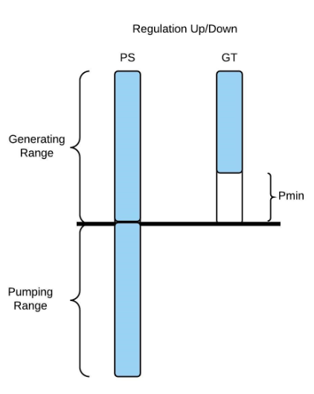
Flexible Capacity: Regulation Up/Down
Secondary control - occurs within seconds to minutes via automatic generation control
Provided by generators who are online and have capacity to increase or decrease output
 | Capacity Assumptions | Usable Capacity Range (% of Nameplate)* | Capital Costs (2018 $/kW)
PS | Capacity to increase/decrease system output by reducing/increasing generation or load Fast switching between modes doubles the effective range unit. | 200% | $1,220
ICE | Capacity of conventional generators to provide regulation up and down is limited by ramp rate and minimum power generation levels. | 79% | $2,223
Aero |  | 47% | $3,583
Frame†
 |  | 87% | $1,677
*Assuming operating state is at optimal position for providing frequency response [ex. GT at Pmin]
†Frame units are not usually used for Regulation given their limited operating flexibility

Slide 10
Spinning vs. Non-Spinning Reserves
Spinning/Non-spinning reserves are used to meet the same operating reserve obligation
Fast response of ternary pumped storage units allows for provision of either spinning or non-spinning reserves, even when in charging mode
Spinning
Non-Spinning
Minimum spinning reserves obligation
Total reserves obligation

Slide 11
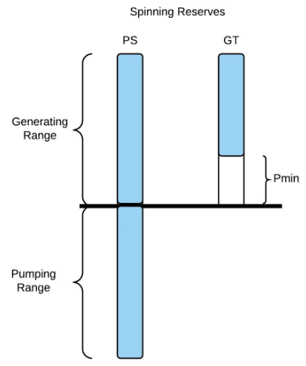
Flexible Capacity: Spinning Reserves
Tertiary control - system operator dispatches reserves in response to contingencies
Provided by units that are synchronized to the grid and able to ramp up within specified time frame
 | Capacity Assumptions | Usable Capacity Range (% of Nameplate)* | Capital Costs (2018 $/kW)
PS | Fast ramp rate and mode switching allows for fast response to operator dispatch Unit in generation, idling, or pumping mode Can increase/decrease load or generation Can switch from one mode to another | 200% | $1,220
ICE | Limited by ramp rate, start-up times (hot-start) | 79% | $2,223
Aero |  | 47% | $3,583
Frame
 |  | 87% | $1,677
*Assuming operating state is at optimal position for providing frequency response [ex. PS pumping, GT at Pmin]

Slide 12
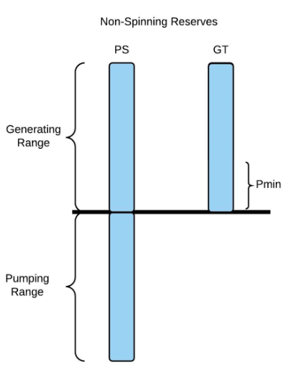
Flexible Capacity: Non-Spinning Reserves
Tertiary control - system operator dispatches reserves in response to contingencies
Provided by units that are not necessarily synchronized to the grid, but able to ramp up generation within specified time frame
Required response time is slower than spinning reserves
 | Capacity Assumptions | Usable Capacity Range (% of Nameplate)* | Capital Costs (2018 $/kW)
PS | Unit in standby mode If dispatched, can quickly ramp up capacity | 200% | $1,220
ICE | Capacity and participation limited by ramp rate, start up time (cold-start) | 100% | $1,756
Aero |  | 100% | $1,684
Frame
 |  | 100% | $1,459
*Assuming operating state is at optimal position for providing frequency response [ex. PS pumping, GT not on]

Slide 13
Additional Flexible Capabilities
Operating Characteristic | Gordon Butte Pumped Storage Ternary Unit | Aeroderivative CT | Frame CT | ICE
Additional cost for each start | Minimal | Yes | Yes | Yes
Estimated median cold start cost* | n/a | $32/MW | $103/MW | Not provided
Can absorb overgeneration? | Yes | No | No | No
Black start? | Yes | Yes** | Yes** | Yes**
*Intertek APTECH (2012). Power Plant Cycling Costs. http://wind.nrel.gov/public/wwis/aptechfinalv2.pdf
**Siemens (2006). Black Start Studies. https://w3.usa.siemens.com/datapool/us/SmartGrid/docs/pti/2006June/Black_Start_Studies.pdf

Slide 14
Conclusions
Compared to the conventional resources described in NWE’s 2015 IRP filing, Ternary Pumped Storage can provide the following services at a cheaper per-kW installed price:
Frequency Response
Regulation Up / Down
Spinning Reserve
Non-Spinning Reserve
Beyond the ability to provide flexible and peak capacity considered here, this analysis does not reflect a pumped storage facility’s ability to store energy for use later, which enables
Absorption of overgeneration
Arbitrage of energy price spreads
Increased transmission system utilization

