Slide 1
Resource Adequacy and Planning Reserve Margins
Technical Conference on Capacity Planning and Resource Adequacy
Montana Public Service Commission
Helena, Montana
June 8, 2017
Arne Olson, Partner

Slide 2

Energy and Environmental Economics, Inc. (E3)
Fast-growing consultancy based in San Francisco
Rigorous analysis on a wide range of energy issues for utilities, regulators, government agencies, power producers, technology companies, and investors throughout North America and around the world
Resource planning & procurement, asset valuation, cost of service & rate design, DER cost-effectiveness, energy storage analysis, renewable integration, transmission planning, deep decarbonization pathways
Our experience has placed us at the nexus of planning, policy and markets
Notes:
2

Slide 3
INTRODUCTION: WHAT IS CAPACITY AND WHO IS RESPONSIBLE FOR IT?

Slide 4
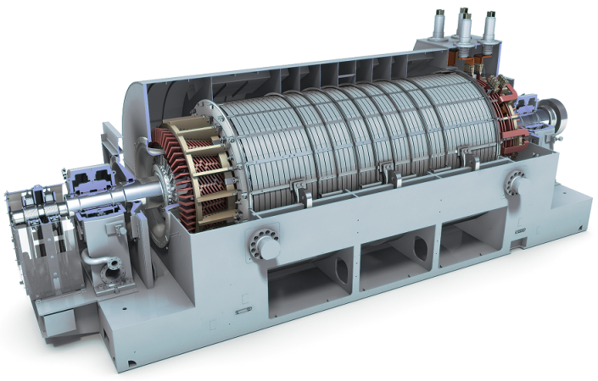

What is “capacity” and why is it important?
Capacity is the ability to generate electric energy at any given point in time
Utilities need adequate generation capacity to meet continuously-varying electric loads reliably over a broad range of conditions
The consequence of inadequate capacity is loss of load
Loss of load is inconvenient, expensive, and potentially life-threatening
Utilities plan their systems to ensure that loss of load occurs very rarely
Source: http://www.energy.siemens.com

Slide 5
Planning vs. operating reliability
Operating reliability
Purpose: avoid cascading outages
Utility function: Balancing Area operations
Governed by: NERC and WECC
Standards: NERC Control Performance Standards (CPS) and Balancing Authority Ace Limit (BAAL)
Products needed: Operating reserves (regulation, freq. response, spin, & non-spin)
Planning Reliability
Purpose: ensure sufficient capacity to meet load
Utility function: resource planning and procurement
Governed by: state and local authorities
Standards: Planning Reserve Margin or Loss-of-Load standard (e.g., 1 day in 10 years)
Products needed: generation capacity, dispatchable loads
Today’s topic

Slide 6
“Pure capacity” vs. “Flexible capacity”
“Pure capacity” is the capacity needed to meet loads under all possible conditions, subject to acceptable reliability standards
Pure capacity can be standardized and denominated in Effective MW
Effective MW is often lower than Nameplate MW
All Effective MW are the same
An analytical process is needed to determine an Effective MW rating for each resource
“Flexible capacity” does not have a standard definition and is not a Resource Adequacy issue
There are many attributes that contribute to power system flexibility: ramp rate, start time, min up/down time
All resources are flexible to varying degrees
Today’s topic

Slide 7
Who is responsible for ensuring adequate capacity?
FERC?
Resource planning and procurement is state-jurisdictional
Some states have opted to participate in organized wholesale electricity markets with FERC-jurisdictional capacity markets
NERC? WECC?
NERC and WECC develop operating standards aimed at ensuring operational reliability
NERC publishes information on resource adequacy planning but does not have mandatory planning standards
Utilities, state commissions and local governing bodies
Utilities and their regulators are ultimately responsible for ensuring resource adequacy in their jurisdictions

Slide 8
Why is resource adequacy important now?
Resumption of load growth and retirements of large power stations are creating the need to invest in new capacity
Wave of construction after 2000-2001 energy crisis, combined with 2008 recession, created significant regional capacity surpluses
Utilities frequently identified “Market Purchases” as a resource in IRPs
Northwest Power and Conservation Council now estimates regional capacity shortfall in 2021
Utilities are now identifying new capacity in IRPs
Northwestern Energy: 400 MW of new gas-fired capacity
Portland General Electric: 775-950 MW of new capacity
Arizona Public Service: 5400 MW of new gas-fired capacity

Slide 9
Why don’t wholesale markets build capacity on their own?
Wholesale markets facilitate more efficient operations and exchange of surplus energy
Western Interconnection is still dominated by vertically-integrated utility systems, in which new capacity is backstopped by captive ratepayers
Developed by utilities as rate-based asset or procured from third parties via long-term PPA
Even “organized markets” in regions with retail competition have required “bolt-on” capacity auctions to incent new construction
ERCOT is lone exception

Slide 10
Methods and PRACTICES for determining prm

Slide 11
How do utilities ensure that they have adequate capacity?
Utilities calculate a Planning Reserve Margin (PRM) to account for operating reserves, extreme weather, generation outages
PRM = % above 1-in-2 (average year) peak load
Typical range is 12-20%
PRM used as an entry in load-resource table for determining resource need
Example Load-Resource Table
Unit | MW
Natural Gas | 1,809
Colstrip | 296
Hydro Projects | 575
Mid-C Hydro Agreements | 123
Other Contracts | 9
DSM | 126
Renewables | 127
Imports | 92
Total Available Dependable Capacity | 3,157
1-in-2 Peak Load | 3,525
Planning Reserve Margin | 550
Total Dependable Capacity Needed | 4,075
Dependable Capacity Shortage | 918
PRM (%) | 15.6%
Source: Portland General Electric, August 2015

Slide 12
How do utilities determine the right Planning Reserve Margin?
PRM is a simple concept, however calculations can be quite detailed
Practices for calculating a PRM are widely varied across the industry. Some examples include:
PRM of 15% based on its common use across the industry
Rule of thumb: 6% for operating reserves + 3% for forced outages + 3% for more extreme weather
PRM based on largest single generator or transmission outage
PRM based on detailed loss-of-load probability (LOLP) study

Slide 13
Industry “best practice”: reliability study based on LOLP
Evaluate possible load and resource conditions over thousands of simulated years to determine resources needed to meet defined reliability target
Reliability target is typically defined as “1 day in 10 years”, though again there is no industry standard
Reliability is modeled using Loss-of-Load Probability (LOLP) modeling techniques
Definition of reliability metrics:
Loss of Load Probability (LOLP): Prob. shortfall in a given hour
Loss of Load Expectation (LOLE): Expected hours of capacity shortfall over a year, sum of LOLP across the entire year
Expected Unserved Energy (EUE): Expected load not served over a year, sum of LOLP x MW shortfall across the entire year
Effective Load-Carrying Capability (ELCC): Quantity of additional load that can be served by variable resources while maintaining reliability

Slide 14
Conventional generators are not 100% reliable
LOLP analysis calculates a distribution of conventional generation availability based on forced outage rates
Generator 1 = On (P=95%) or Off (P=5%)
Generator 2 = On (P=97%) or Off (P=3%)
Etc.
Distribution represents probability that the portfolio has a given quantity of available capacity
Distribution is wider, and required PRM is higher, if:
System has few generators
Resources have higher outage rates
Probability
Available Thermal Generation (MW)

Slide 15
Loss of load occurs when available generation is less than load
Loads also vary significantly due to weather
Load is most likely to exceed generation during hours with high load, high generator outages, or both
Generation distribution
Load distribution
Load
Generation
Load > Generation
LOLP

Slide 16
“Heatmap” shows when loss of load occurs on a given system
Chart shows hours of LOLP by month/hour timeslice
Sum of time slices is test year LOLE
Month
HE PST
Source: Portland General Electric, August 2015

Slide 17
Planning criteria used by utilities are widely varied
 | Peak Demand in 2021 (MW) | Planning Criterion | PRM | Peak Season
Puget Sound Energy | 7,000 MW | LOLP: 5%* | 16% (2023 - 2024) | Winter
Avista | Summer: 1,700 MW; Winter: 1,900 MW | LOLP: 5%* | 22% (14% + operating reserves) | Both
PacifiCorp | 10,876 MW | LOLE: 2.4 hrs/ year | 13% | Summer
Arizona Public Service | 9,071 MW | One Event in 10 Years | 15% | Summer
Tuscon Electric Power | 2,696 MW | PRM | 15% | Summer
Public Service Co. of New Mexico | 2,100 MW | LOLE: 2.4 hrs/ year | Greater of 13% or 250 MW | Summer
El Paso Electric | 2,000 MW | PRM | 15% | Summer
Cleco | 3,000 MW | LOLE = 1-day-in-10 yrs. | 14.8% | Summer
Kansas City Power & Light | 483 MW | Share of SPP** | 12%** | Summer
Oklahoma Gas & Electric | 5,500 MW | Share of SPP** | 12%** | Summer
South Carolina Electric & Gas | 5,400 MW | 24 to 2.4 days/10 yrs | 14-20% | Both
Tampa Electric | 4,200 MW | PRM | 20% | Both
Interstate Power & Light | 3,300 MW | PRM | 7.3% | Summer
Florida Power and Light | 24,000 MW | PRM | 20% | Both
California ISO | 52,000 MW | LOLE: 0.6 hours/year | 15-17% | Summer
* PSE and Avista use NWPCC criterion of 5% probability of shortfall occurring any time in a given year
** SPP uses 1-day-in-10 years or 12% PRM system-wide

Slide 18
RENEWABLES AND FLEXIBLE CAPACITY

Slide 19
Renewable resources contribute to resource adequacy
Illustrative Capacity Values
No resource is perfectly available to help reduce LOLP
By convention, dispatchable resources rated at nameplate and forced outages factored into PRM
Non-dispatchable resources assigned “effective capacity” rating
95 MW Capacity Value
60 MW Capacity Value
100 MW nameplate
20 MW Capacity Value

Slide 20
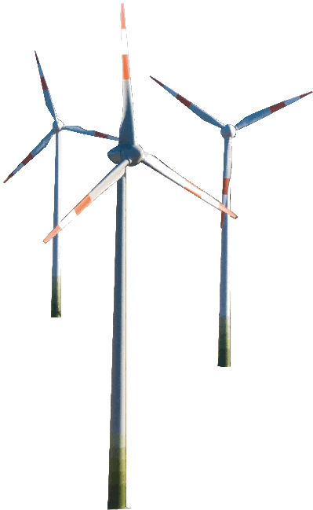
Methods for estimating capacity credit of renewables
Heuristic approximations
Time window methods
Average or percentile capacity factor during highest load hours
Currently the most common industry method due to ease of calculation
Simple and easy to understand but increasingly inaccurate at high penetrations
Reliability based methods
Effective Load Carrying Capability (ELCC)
After new variable generation is added to a system, ELCC is defined as the additional load that can be added to the system while still maintaining the original system reliability (original annual LOLE)
Accurate but computationally intensive
Accurately measuring the contribution of renewable energy becomes increasingly important as its share of system capacity grows!

Slide 21
Methods for estimating capacity credit of renewables vary widely
 | Approach | Notes
BPA | Time window | Wind is assigned zero value
California PUC | Time-window | Dec-Mar, 4-9 pm, Apr-Oct, 1-6 pm
Idaho Power | Time-window | Summer, 3-7 pm
ISO New England | Time-window | Jun-Sep, 2-6 pm
New York ISO | Time-window | Jun-Aug, 2-6 pm, Dec-Feb, 4-8 pm
Ontario IESO | Time-window | Capacity factor over the top 5 contiguous daily peak demand hours
PJM | Time-window | Jun-Aug, 4-6 pm
PNM | Time-window | Peak hour
Quebec Balancing Authority Area | Other | Monte Carlo analysis supplemented by analysis of fourteen critical extreme cold weather events
Arizona Public Service | ELCC | Average capacity value over several years of LOLE simulations
BC Hydro | ELCC
ERCOT | ELCC
Midwest ISO | ELCC
PSCO/Xcel | ELCC | Based on 10-year ELCC study

Slide 22
Effective Load-Carrying Capability
Adding renewables reduces LOLE due to expectation of non-zero production
Adding load returns system to the original LOLE
The amount of load that can be added to the system is the Effective Load-Carrying Capability (ELCC) of the renewables
Original system LOLE
Additional load to return to original system LOLE
= ELCC
LOLE after renewables

Slide 23
ELCC method: Subtract renewables from load in LOLP calculations
Renewable production is subtracted from gross load to yield “net load”, which is always lower
LOLP decreases in every hour
Net thermal generation distribution
Gross load
Net load distribution with renewables
Gross load distribution
Renewable
net load
Thermal generation
Reduction in LOLP with increase in renewables

Slide 24
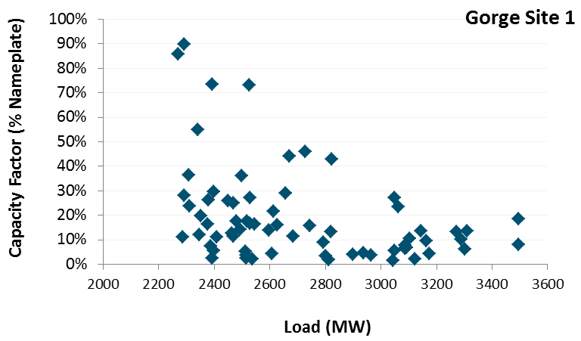
Factors that affect the capacity value of variable generation
Coincidence with load
Resources with better correlation with high load periods have higher ELCC
Coincidence with existing portfolio
Adding more capacity of the same type results in lower marginal value
Adding diversity results in higher marginal value
Variability
Statistically, the possibility of low production during a peak load event reduces the value of a resource
August
Weekday, HE17

Slide 25
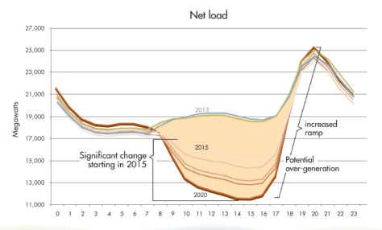
How is “Flexible Capacity” related to Resource Adequacy?
Under flexibility-constrained operations, reliability can be maintained through renewable dispatch, at the cost of lost production
Without renewable dispatch: shedding of firm load required
With renewable dispatch: no load shedding required
Strategy to Minimize Downward Violations
Strategy to Minimize Upward Violations
Unserved Energy
Limited Ramping Capability
Limited Ramping Capability
Renewable Curtailment
Capacity does not need to be “flexible” for Resource Adequacy purposes, but flexibility does help with operations & curtailment. Key question: how much to pay for additional flexibility?

Slide 26
Role of regional market

Slide 27
Interactions with the regional market
Conventional methods effectively assume that each system is an island
Long-term contracted resources treated as owned
Generic imports can be represented as a resource, perhaps with transmission outage rate
Many utilities rely on “market purchases” to fill energy and capacity gaps
Based on assumed availability of resources
Regional market conditions typically not analyzed rigorously
How much capacity can a utility count on being able to acquire from its neighbors?

Slide 28
Are current practices sufficient to maintain reliability?
Current practices rely on 16 states & provinces and many local jurisdictions to adopt practices that maintain reliability across our multi-state regional grid
Current system can work as long as:
Every utility calculates its own needs in a sufficiently robust manner
Every utility builds or identifies physical resources to meet its own needs
New resource additions are approved in a timely manner
However, analysis is complex and often contentious

Slide 29
Benefits of regional planning reserve sharing
Regional planning reserve sharing would take advantage of load and resource diversity that exists across regions
A system in which each utility builds physical assets to meet its own needs will result in overcapacity, because not every system peaks at the same time
Planning to meet regional coincident peak loads requires less capacity than meeting each individual utility’s peak loads
Resources that are surplus in one area could be utilized to meet a deficit in a neighboring area
Larger systems require lower reserve margins because they are less vulnerable to individual, large contingencies
Regional entity could adopt more sophisticated practices and computer models than individual utilities
Regional entity would provide calculation of capacity need that is independent from the utility

Slide 30
conclusion

Slide 31
Key questions for regulators in assessing resource adequacy
How accurate or reliable is the utility’s peak load forecast?
How robust is the utility’s method for determining its Planning Reserve Margin?
How accurate is the utility’s method for estimating the capacity contribution of renewables?
How can the utility know how much capacity is available in the regional market?
How much should utility be willing to pay for flexible capacity?

Slide 32
Thank You!
Energy and Environmental Economics, Inc. (E3) 101 Montgomery Street, Suite 1600 San Francisco, CA 94104 Tel 415-391-5100 Web http://www.ethree.com
Arne Olson, Partner (arne@ethree.com)

